Slide 1







yrics-based music genr classification
Team 18 – Data Science Project

Slide 2

Team members
Hoàng Văn An - 20204864
Trương Quang Bình - 20200068
Lê Trần Thắng - 20204926
Trần Khánh Lương - 20204882
Hoàng Xuân Việt - 20200662

Slide 3
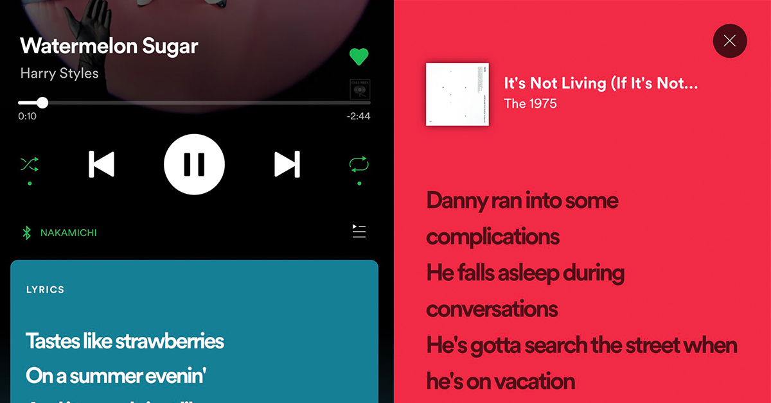

Topic description and motivation

Slide 4
Topic description and motivation

Slide 5

Data preparation agenda
Data crawling
Cleaning data
Analysis Data

Slide 6
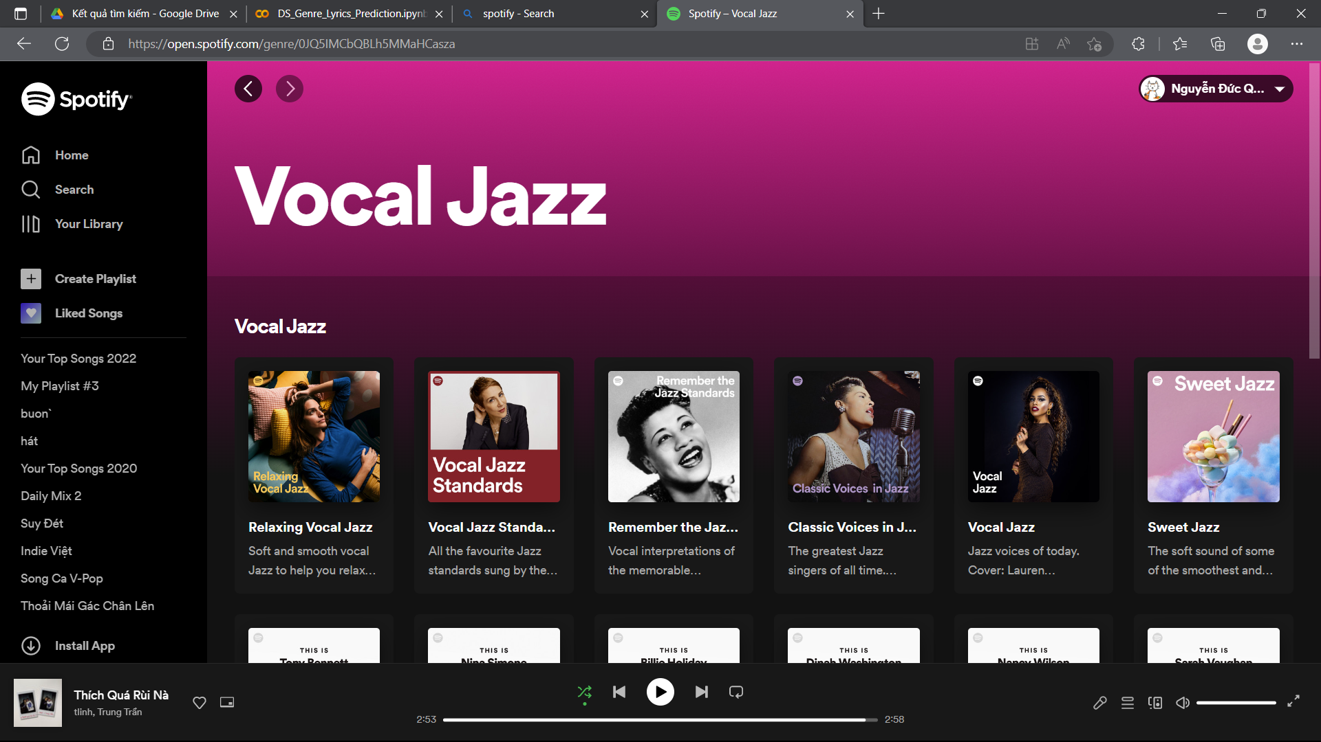
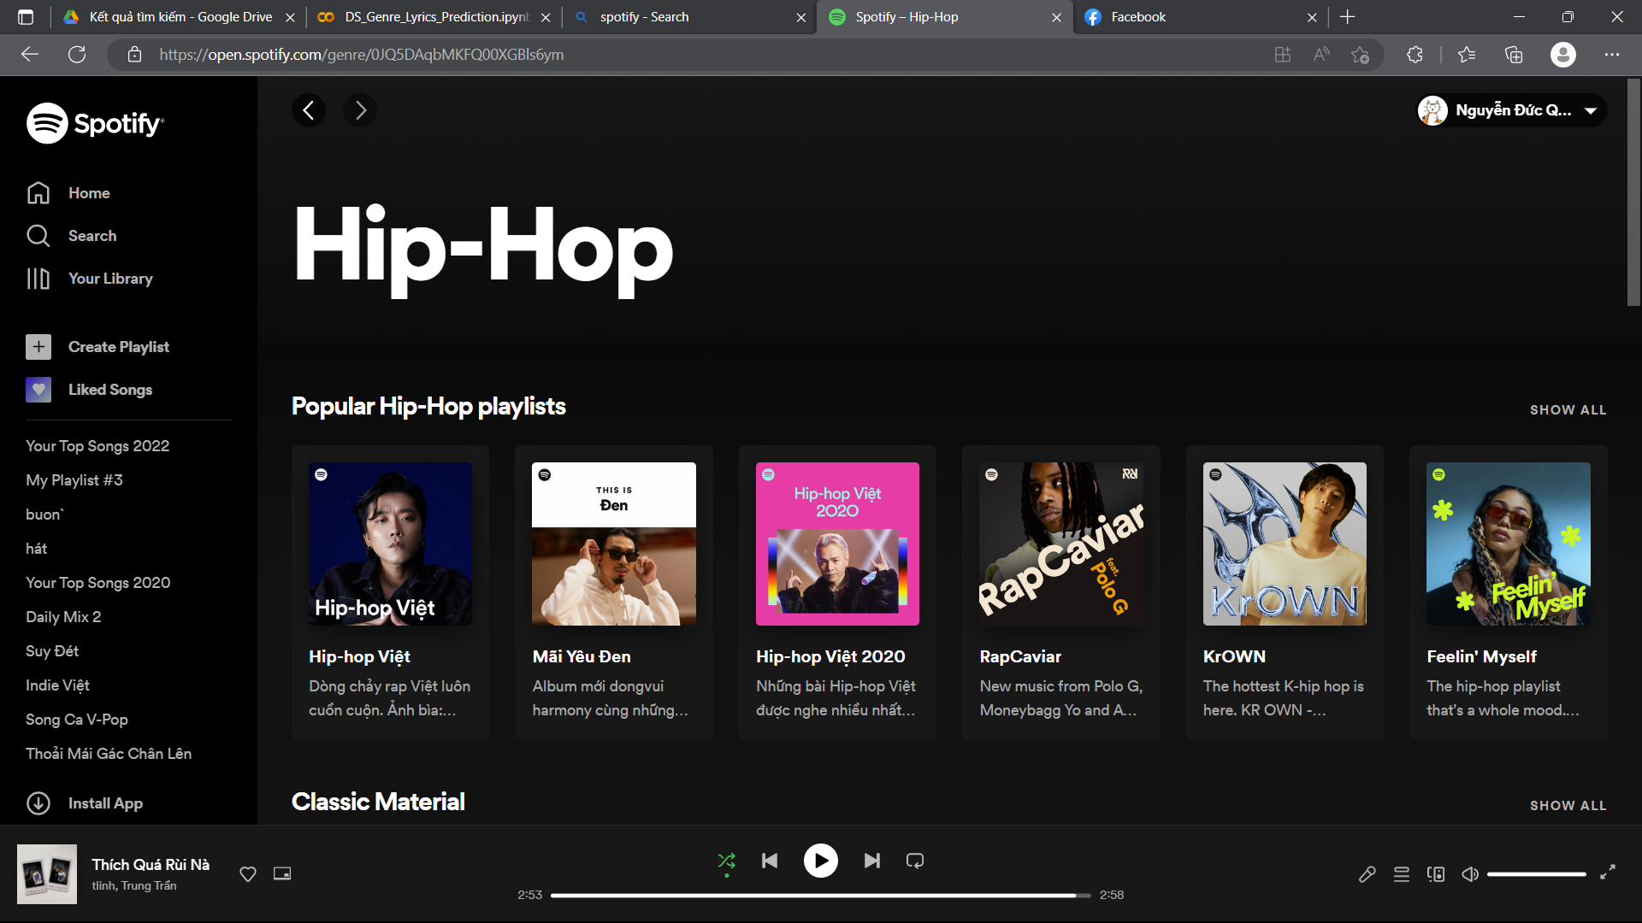
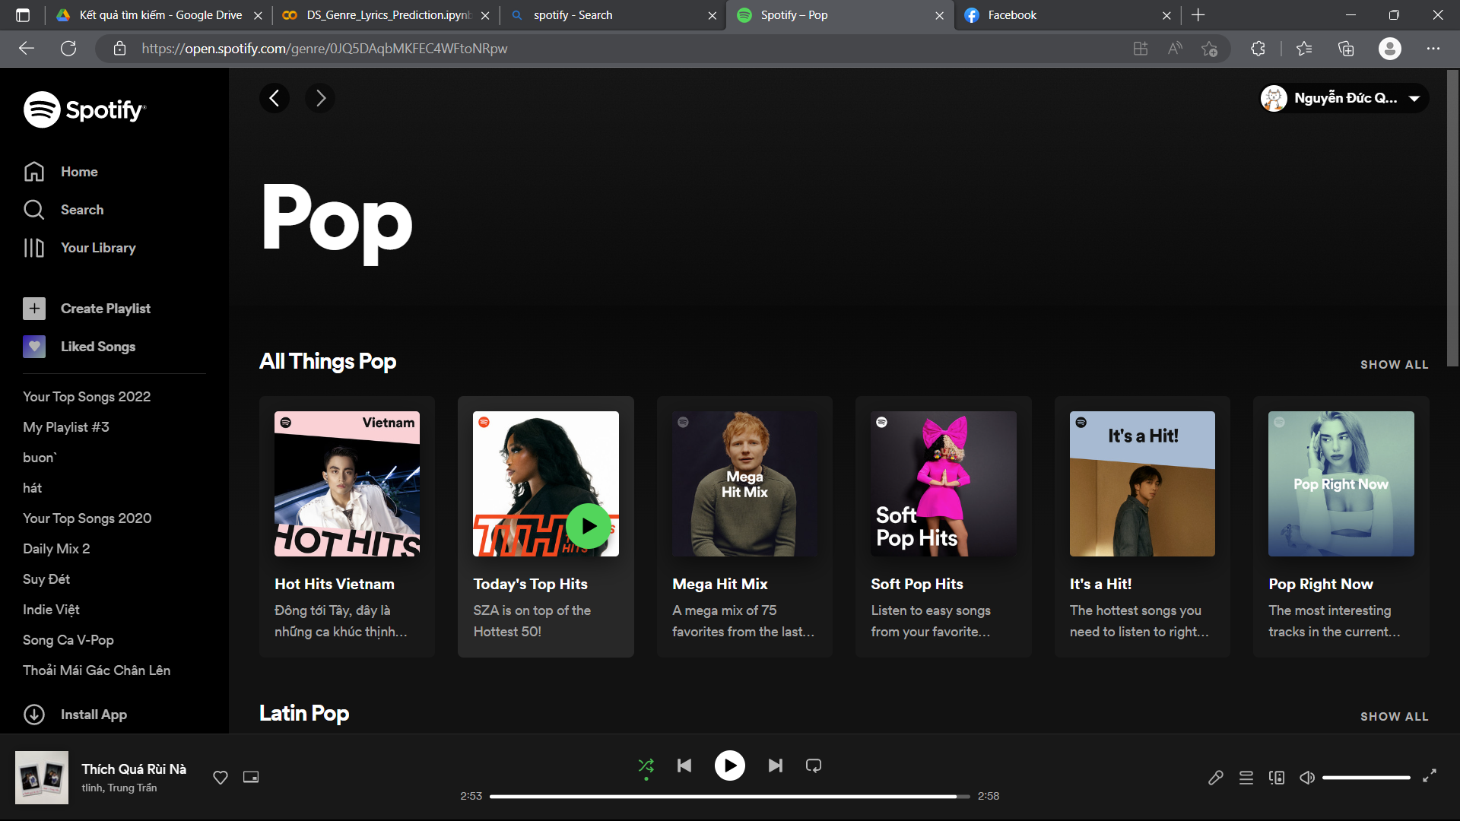
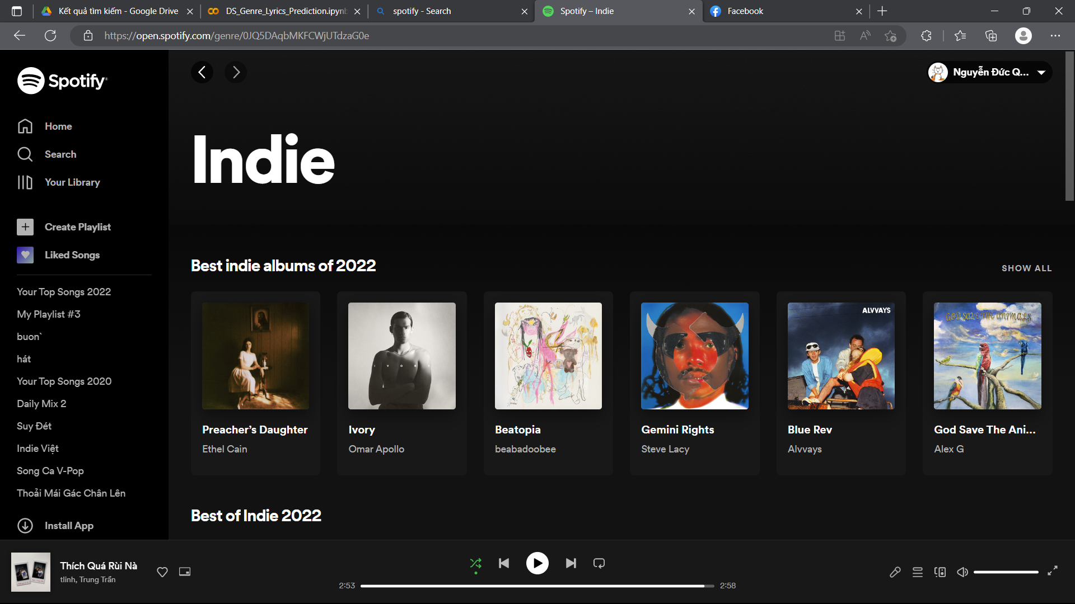
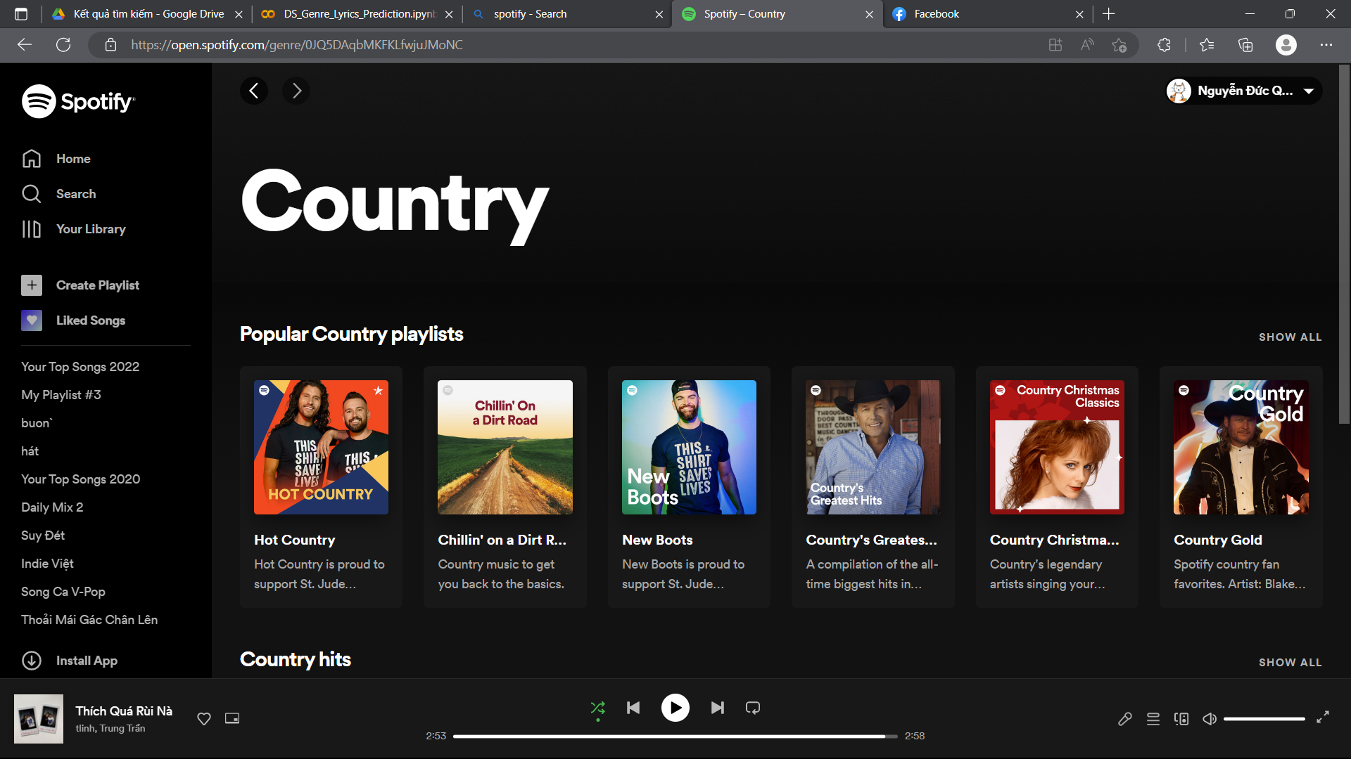
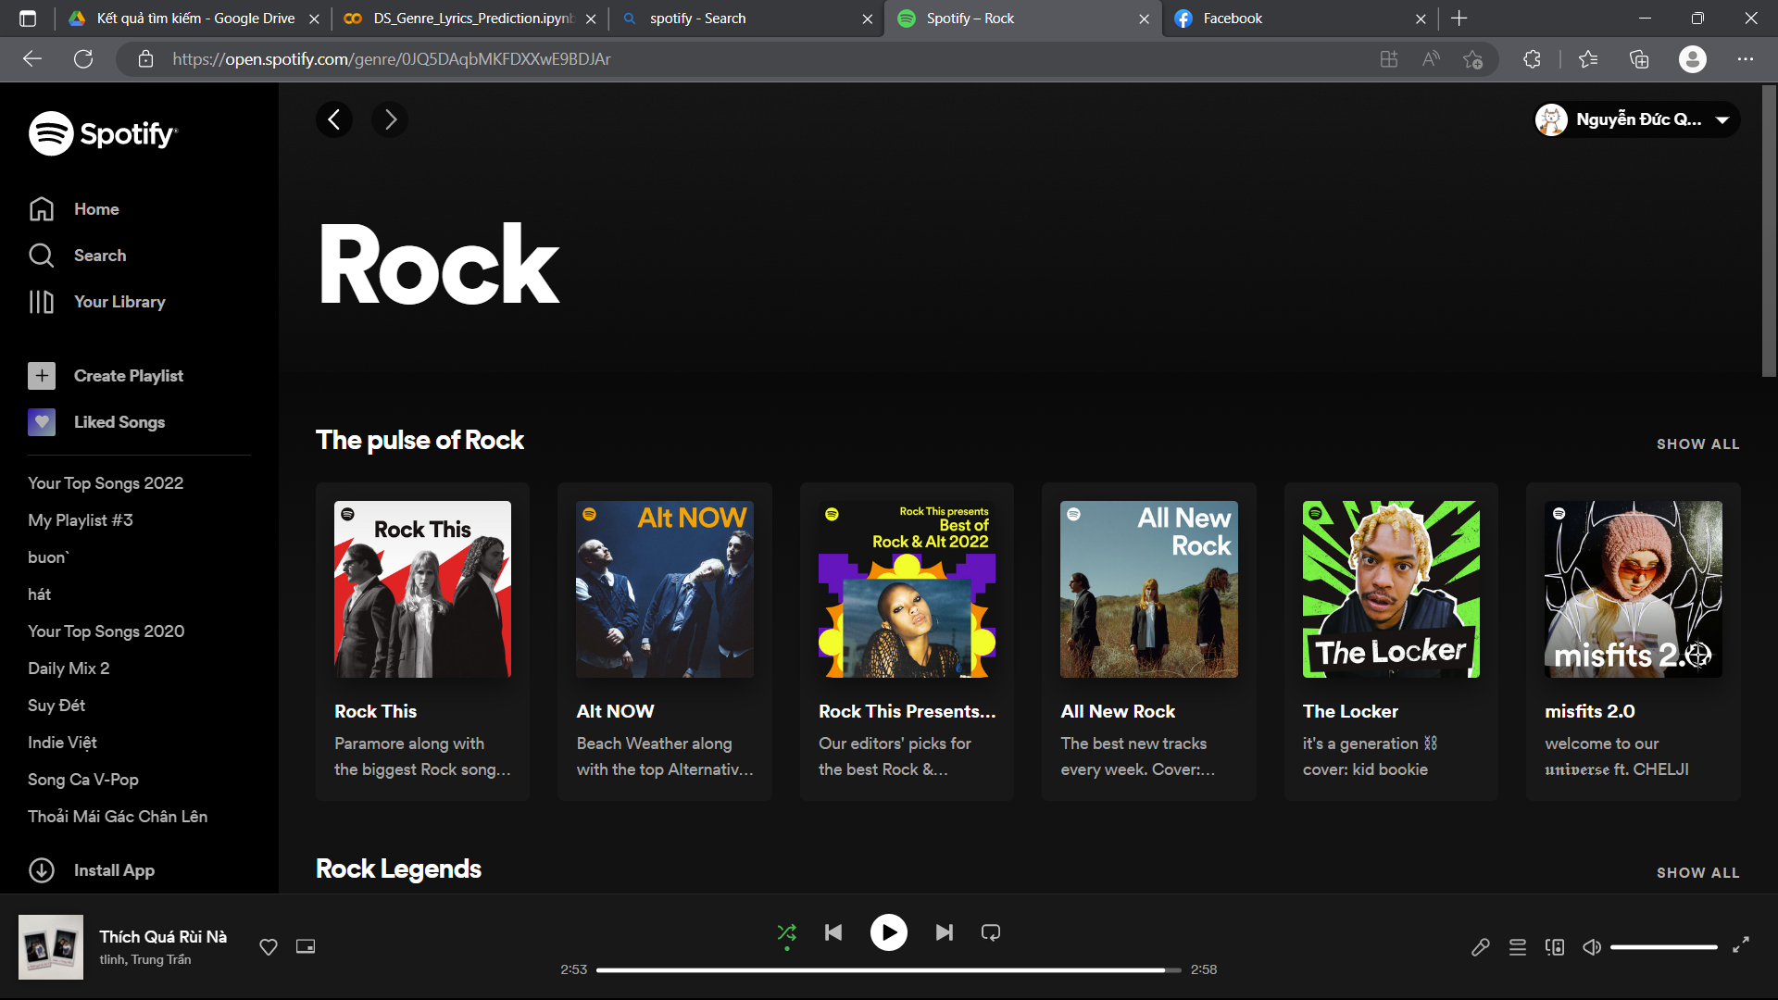
Data crawling
Crawling from playlists of each Spotify genres

Slide 7
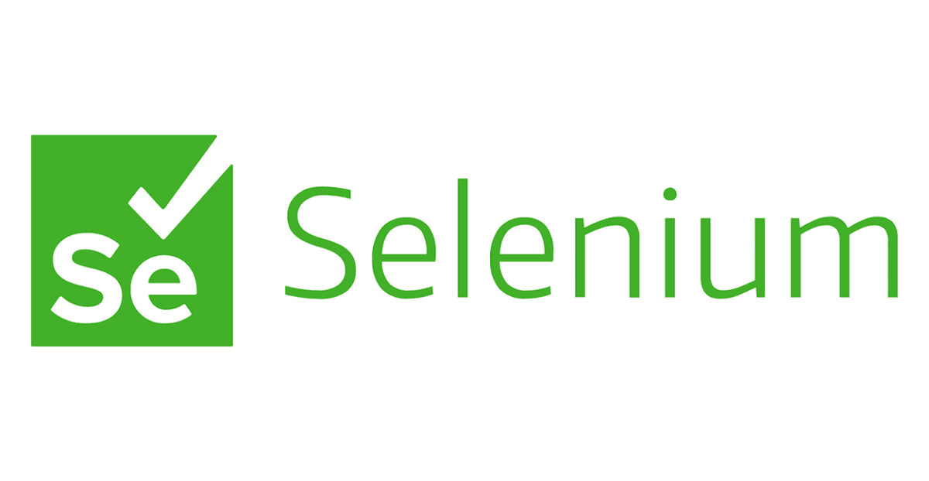

Data crawling
Crawling tools used:
Features:
Song name
Song lyric
Genre/category

Slide 8
Cleaning data
Export CSV file
Remove special characters in lyrics, lower, strip, lemmatize…
Remove non-English files
Remove empty files

Slide 9
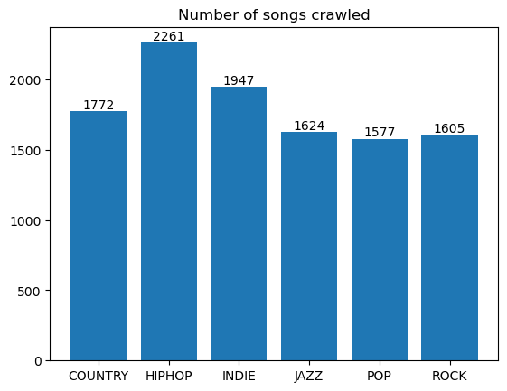
Analysis Data
1500 songs

Slide 10
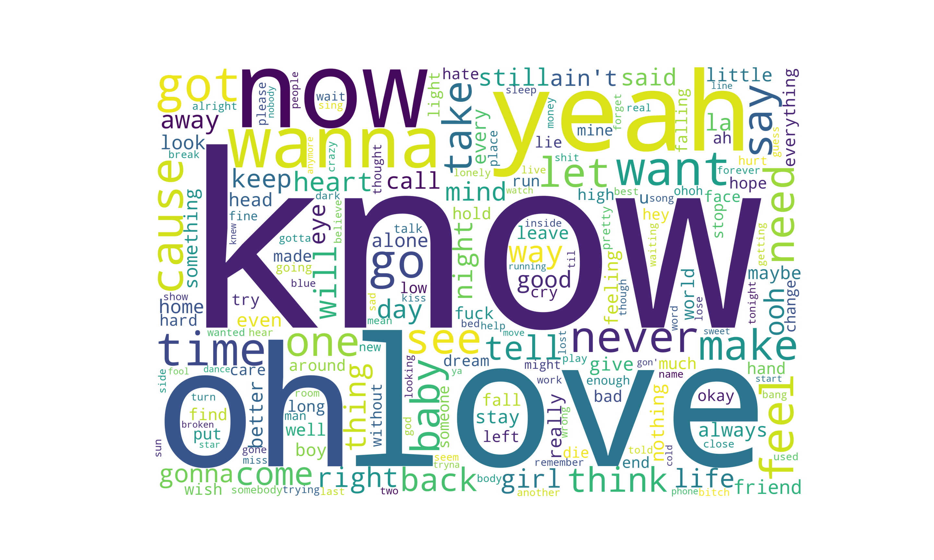
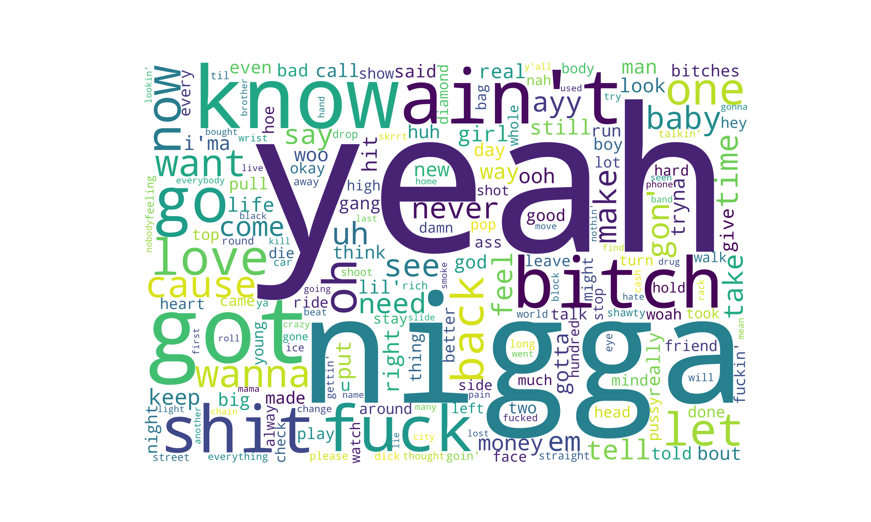
“WordCloud” representation
Analysis Data

Slide 11
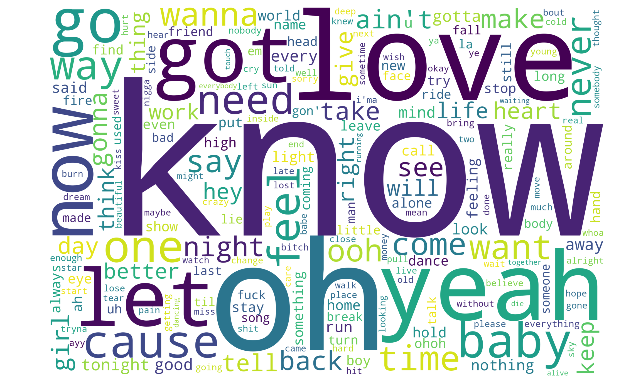
“WordCloud” representation
Analysis Data

Slide 12
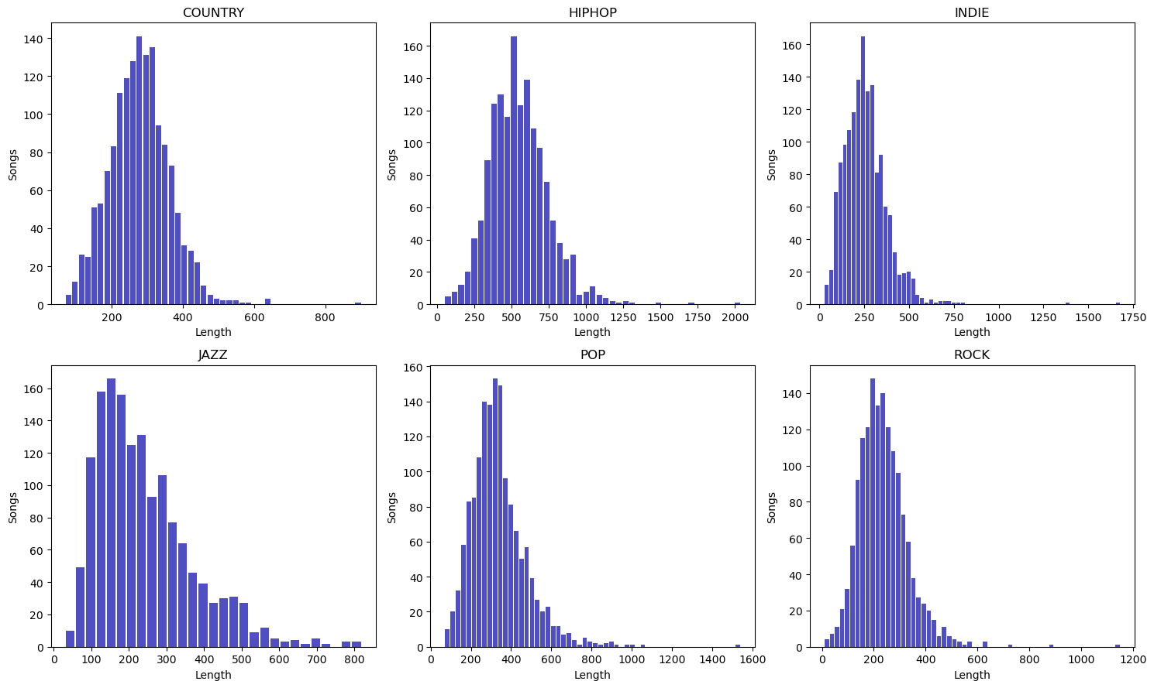
Histogram - length

Slide 13
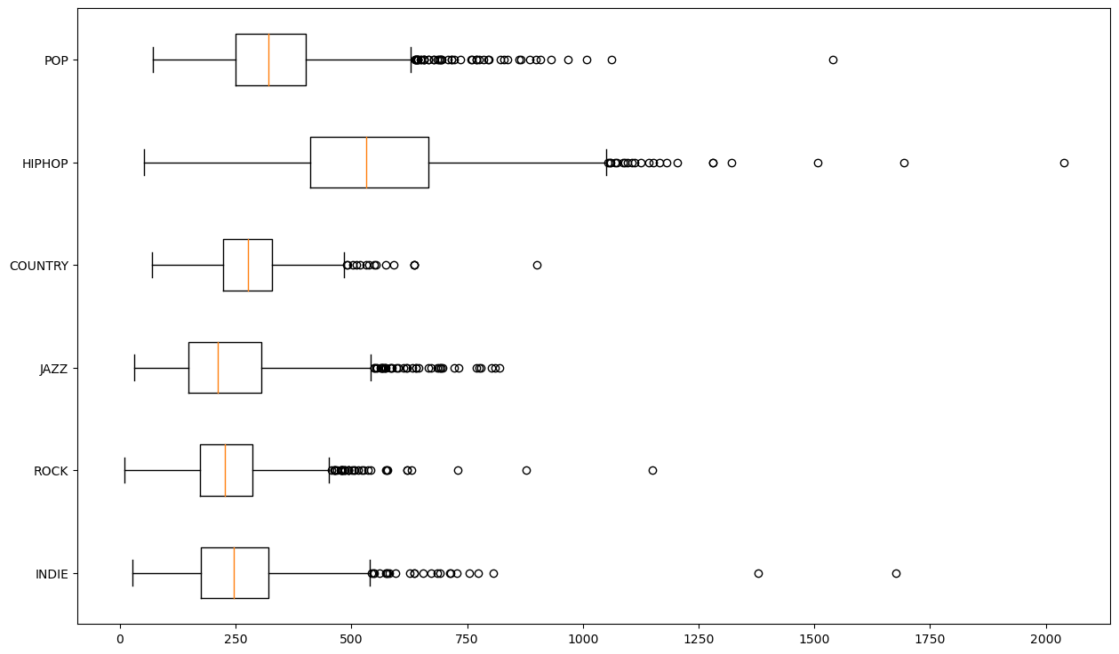
Boxplot – song length

Slide 14
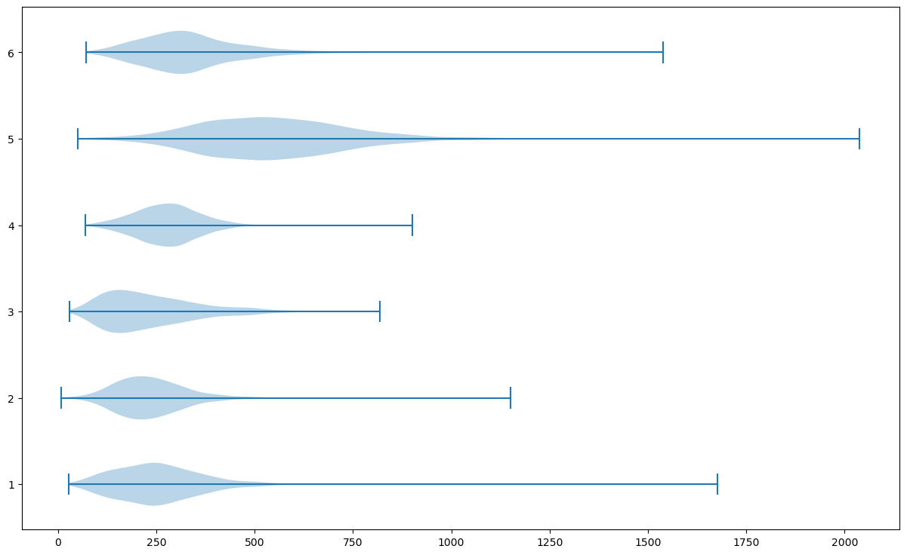
Violin plot - song length

Slide 15
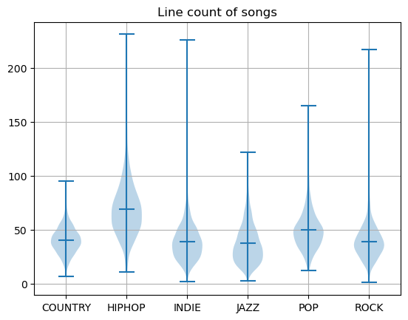
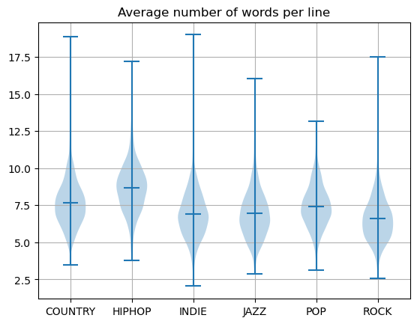
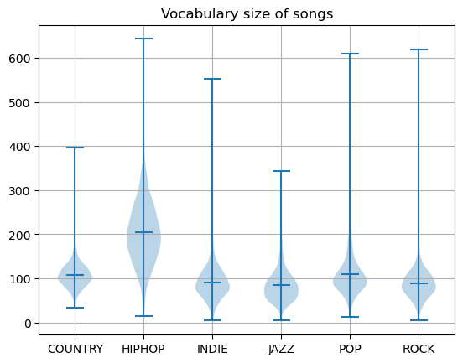
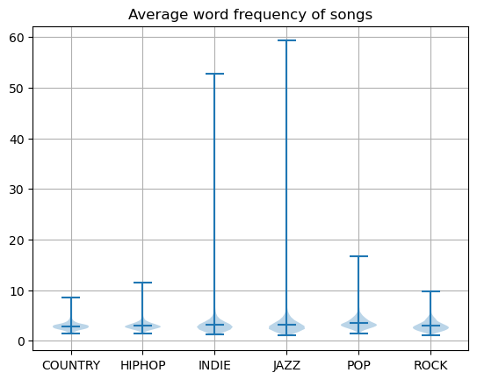
Violin plot – other plots

Slide 16
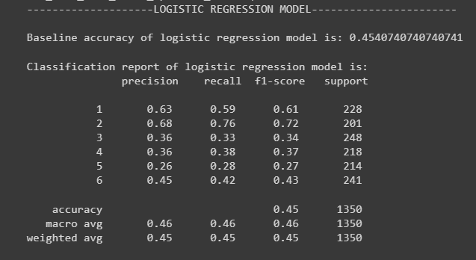
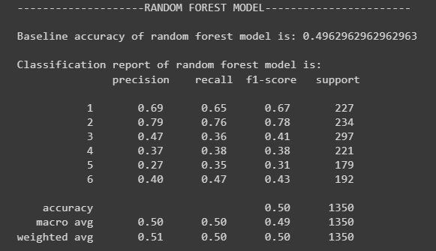
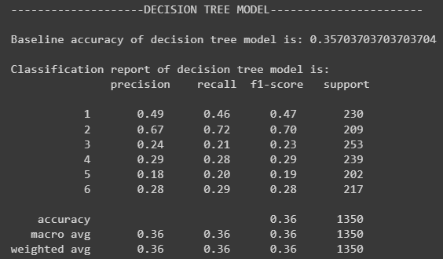
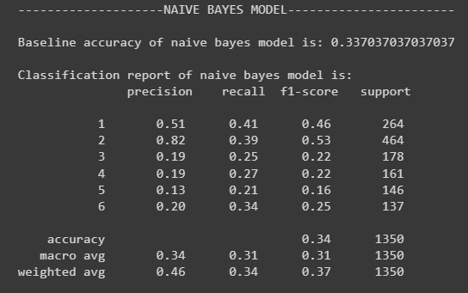
Basic ML algorithm

Slide 18
Future work
Apply Deep Learning models
RNN
LSTM
CNN
Crawling more data

Slide 19
THANK YOU
FOR YOUR LISTENING

Slide 20
Big Data Infographics
Educate
Explore
Engage
Execute
Mercury is the closest planet to the Sun and the smallest one
Despite being red, Mars is actually a cold place. It’s full of iron oxide dust
Jupiter is a gas giant and the biggest planet in the Solar System
Mercury is the closest planet to the Sun and the smallest one

Slide 21
Big Data Infographics
75%
Mars
Mars is actually actually a cold place. It’s full of iron oxide dust
50%
Mercury
60%
Mercury is the closest planet to the Sun and the smallest one
Saturn
Saturn is composed of hydrogen and helium and is the ringed one

Slide 22
Big Data Infographics
Data
Decision
Despite being red, Mars is a cold place full of iron oxide dust
01
02
Venus has a beautiful name, but also very high temperatures
Info
Insight
Mercury is the closest planet to the Sun and the smallest one
04
03
Jupiter is a gas giant and the biggest planet in the Solar System

Slide 23
Big Data Infographics
Data
Decision
01
Despite being red, Mars is a cold place. It’s full of iron oxide dust
Mars is full of iron oxide dust, which gives the planet its reddish cast
02
04
Insight
Info
03
Mercury is the closest planet to the Sun and the smallest one of them all
Jupiter is a gas giant and the biggest planet in the Solar System

Slide 24
Big Data Infographics
Mars
Jupiter
Mercury
Despite being red, Mars is actually a cold place. It’s full of iron oxide dust
Jupiter is a gas giant and the biggest planet in the Solar System
Mercury is the closest planet to the Sun and the smallest one

Slide 25
Big Data Infographics
70%
35%
80%
50%
Mercury
Mars
Jupiter
Saturn
Mercury is the closest planet to the Sun and the smallest one
Despite being red, is actually cold and full of iron oxide dust
It’s a gas giant and the biggest planet in the Solar System
Saturn is composed mostly of hydrogen and also helium

Slide 26
Big Data Infographics
A
18%
Mercury
B
C
92%
Mars
D
83%
Saturn
Mercury
Saturn
Mercury is the closest planet to the Sun
It’s composed of hydrogen and of helium
Mars
Neptune
77%
Neptune
Despite being red, Mars is a cold place
Neptune is the farthest planet from the Sun

Slide 27
Big Data Infographics
Mercury
Mercury is the closest planet to the Sun
Mars
Despite being red, Mars is a cold place
Saturn
It’s composed of hydrogen and helium
Neptune
It’s the farthest planet from the Sun
55%
74%
67%
89%

Slide 28
Big Data Infographics
Data Risk
Interpretation Risk
Data Security
Data Quality
Model Risk
Interpretation Risk
Mercury is the closest planet to the Sun and the smallest
Despite being red, Mars is cold and full of iron oxide dust
It’s a gas giant and the biggest planet in the Solar System
Saturn is composed mostly of hydrogen and helium

Slide 29
Big Data Infographics
20%
Venus has a beautiful name and is the second one from the Sun
40%
Mercury is the closest planet to the Sun and the smallest one
60%
Despite being red, Mars is a cold place full of iron oxide dust
Venus
Mercury
80%
Mars
Jupiter
It’s a gas giant and the biggest planet in the Solar System

Slide 30
Big Data Infographics
Mercury
Saturn
Mercury is the closest planet to the Sun
It’s composed of hydrogen and helium
Mars
Neptune
Despite being red, Mars is a cold place
Neptune is the farthest planet from the Sun
20%
60%
40%
80%

Slide 31
Big Data Infographics
Data
Decision
Saturn is a gas giant and has several rings
23%
60%
75%
100%
Mars is full of iron oxide dust and has a reddish cast
Neptune
23%
Venus
60%
Insight
Info
Mercury is the smallest planet in the Solar System
Mars
75%
Jupiter is a gas giant and the biggest planet
Saturn
100%

Slide 32
Big Data Infographics
Venus is the second planet from the Sun
Cost
Despite being red, Mars is a cold planet
Backup
Mercury is the closest planet to the Sun
Safety
Big Data Challenges
Jupiter is the biggest planet of them all
Data Structure
Data Management
Saturn is a gas giant and has several rings
Transformation
Venus has a really beautiful name

Slide 33
Big Data Infographics
Data Security
Despite being red, Mars is actually a cold place
60%
Data Quality
Mercury is the closest planet to the Sun
45%
Model Risk
Jupiter is a gas giant and the biggest planet
70%
Interpretation Risk
Yes, Saturn is the ringed one. It’s a gas giant
50%

Slide 34
Big Data Infographics
Data
Insight
Despite being red, Mars is actually a very cold place
Venus has a beautiful name and is the second planet
45%
90%
65%
70%
25%
40%

Slide 35
Big Data Infographics
Data interpretation
Structured data
Mars is actually a cold place
Jupiter is the biggest planet
Geo expansion
Variability
Mercury is a small planet
Neptune is far away from Earth
50%
40%
30%
20%

Slide 36
Big Data Infographics
Volume
Venus has a beautiful name and is the second one from the Sun
40%
30%
Variety
Mercury is the closest planet to the Sun and the smallest one
Veracity
Despite being red, Mars is a cold place full of iron oxide dust
60%
50%
Value
Jupiter is a gas giant and the biggest planet of them all

Slide 37
Big Data Infographics
Insight 1
Mercury
Planet Mercury is the smallest one in the entire Solar System
Mars
Despite being red, Mars is actually a cold place full of iron oxide dust
90%
70%
40%
Jupiter
Mercury
Mars
Jupiter
90%
70%
40%
Planet Jupiter is a gas giant and the biggest one in the Solar System
Insight 2

Slide 38
Big Data Infographics
01
Volume
Jupiter is the biggest planet of them all
04
Veracity
02
Earth is the planet where we live on
Velocity
5 Vs of Big Data
Venus is the second planet from the Sun
05
Value
03
Mercury is the closest planet to the Sun
Variety
Despite being red, Mars is a cold place

Slide 39
Big Data Infographics
Mars
Despite its reddish cast, it’s actually an incredibly cold place
50%
70%
80%
Mercury
Mercury is the closest planet to the Sun and the smallest one of them all
700$
400$
800$
500$
2017
Saturn
2018
Saturn is a planet composed mostly of hydrogen and helium, and has rings
2019
2020

Slide 40
Big Data Infographics
Low Volume
High Volume
Mercury is the closest planet to the Sun
Jupiter is the biggest of them all
Batch
Small Data vs. Big Data
Real-Time
Despite being red, Mars is a cold place
Venus is the second planet from the Sun
Structured
Multi-Structured
Earth is the planet where we live on
Saturn is the ringed one. It’s a gas giant

Slide 41
Big Data Infographics
Volume
50%
Venus has a beautiful name and is the second one from the Sun
Variety
60%
Mercury is the closest planet to the Sun and the smallest one
Veracity
75%
Despite being red, Mars is a cold place full of iron oxide dust
Value
70%
Jupiter is a gas giant and the biggest planet of them all

Slide 42
Big Data Infographics
Despite being red, Mars is actually a cold place
Value
Mercury is the smallest planet in the Solar System
Veracity
Earth is the third planet from the Sun and the one with life
Variety
Neptune is the farthest planet from the Sun and a gas giant
Velocity
Jupiter is a gas giant and the biggest planet of them all
Volume

Slide 43
Big Data Infographics
Data 1
Data 2
01
Mercury is the smallest planet in the Solar System
02
Mars is actually a cold place, it’s full of iron oxide dust
40%
80%
03
Jupiter is a gas giant and the biggest of them all
04
Saturn is composed of hydrogen and helium
60%
30%
70%
55%
55%
35%

Slide 44
Big Data Infographics
01
Mercury is the closest planet to the Sun
Volume
02
Venus is the second planet from the Sun
Velocity
4 Vs of Big Data
03
Jupiter is a gas giant and the biggest planet
Veracity
04
Yes, this is the ringed one. It’s a gas giant
Variety

Slide 45
Big Data Infographics
Venus
Venus has a beautiful name and is the second planet from the Sun
Data 1
70%
35%
70%
35%
Mercury
Mercury is the closest to the Sun and the smallest one
50%
Mars
65%
Despite being red, it’s a cold place. It’s full of iron oxide dust
Data 2
60%
Jupiter
Jupiter is a gas giant and the biggest planet in the Solar System
40%

Slide 46
Big Data Infographics
Mercury
321k
35%
Mercury is the closest planet to the Sun and the smallest one in the Solar System
288k
Neptune
65%
Neptune is the farthest planet from the Sun. It’s the fourth-largest by diameter
Mars
189k
75%
Despite being red, Mars is a cold place. The planet is full of iron oxide dust

